Slide 1


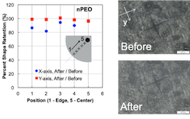
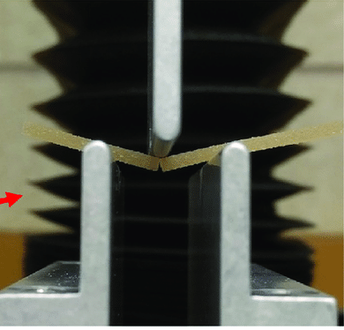
School / Company Logos
Please follow your institution’s branding rules and acquire the logos from communications departments.
TITLE OF THE POSTER
Authors^{1,}
underline presenting author², subscript for affiliation information³
1 first affiliation 2 second affiliation 3 third affiliation
This template is prepared with MDTS logo colors
HIGHLIGHTS
METHODS
RESULTS
This section could be used to highlight the research and motivation.
Font Sizes:
Poster title: 80
Authors: 60
Affiliations: 48
For text, you may use somewhere between 32-48, minimize text and use diagrams. The poster must be legible from 5-6 ft away.
(Tip: Set the screen zoom to 100% and read the text from 6 feet away) – 48 pts
(Tip: Set the screen zoom to 100% and read the text from 6 feet away) – 32 pts
32pt is legible from 6 feet, 60pt is good for 12 ft.
Here, describe your experimental equipment and the research methods you used.
Using a ruler, or alignment tool, align the features with respect to each other (vertical and horizontal).
Consider using short text or bullets.
Also, use a Sans Serif font style (like Arial, Calibri, Futura, Helvetica), Serif style is curly (Times New Roman, Cambria) and is not easy to read on poster. Note that the size of the fonts changes slightly with the style.
Keep heading sizes consistent and well-aligned.
Figures and text should be visible from 5-6 feet away.
Instead of mixing font styles to emphasize, use bold or underscore and their combinations.
Left align text.
And check spelling and typos ☺
x
If you are using images, photos or graphs, make sure their resolution is high (300dpi) and they look sharp when resized larger.
y
Before
BACKGROUND
CONCLUSIONS
This section provides a brief background and places the work in the context of the literature.
To design a good poster, two or three base colors are sufficient.
It is always best to check with your communication department or branding for guidance.
After
72 dpi – resized image,
looks blurry when printed
Concise, to the point conclusions.
Better to have bullets.
And include further study notes.
Before sending to the plotter, view the images and text at 100% zoom.
When printing, you should plan to wait for several hours. So it is always good to print the posters 1-2 days ahead of the events.
150 dpi – not resized image
Usually the font size in the images is overlooked, adjust the font size separately in these images (make them bolder and larger) for easy view.
Use visual help to describe images, not lengthy text.
When adding logos, make sure you have the approved high-resolution logos.
Do not – do not – resize the the images by stretching unproportionally.
Original
Important Information about the Poster Session:
Poster display instructions:
The maximum size of finished posters must not exceed 48 inch x 36 inch (122 cm × 91 cm) in order to fit within the usable area of the poster board, use landscape orientation. Easels, boards, and clips / pushpins will be available on site.
A poster number ID will be mounted on the display area of each poster board. Please attach this ID visibly on the top of your poster. Posters should be printed and brought by each author to the summit.
Authors are requested to stand next to their posters for discussion and to answer questions, during the poster session.
For visually pleasing posters, you may prefer to use dark gray text color.
You may also prefer not to use a background color in text areas to save ink.
Distorted
Original
<- - - - Stretched - - - - >
References:
1. For this section, 24 font size is usually sufficient.
Make sure you cite references correctly in text.
Use a short style of references, MLSA or IEEE reference format is short.
The fourth reference
Acknowledgements:
In this section, check project numbers and funding agency requirements.
Also, this is a great place to acknowledge the people who helped you.
Area for center logos, other affiliation logos.
The 34th Microelectronics Design & Test Symposium (IEEE MDTS 2025) 19-21.May. 2025 | Albany, NY

